Slide 1
Faculteit gedrags- en
maatschappij-
wetenschappen
Leraarenopleiding,
Hoger onderwijs
Student Well-being in Times of COVID-19.
Basic Psychological Need Satisfaction and Frustration Within the University Learning Environment
Lisa Kiltz, Miranda Trippenzee, Joke Fleer, Marjon Fokkens-Bruinsma, Ellen P. W. A. Jansen

Slide 2
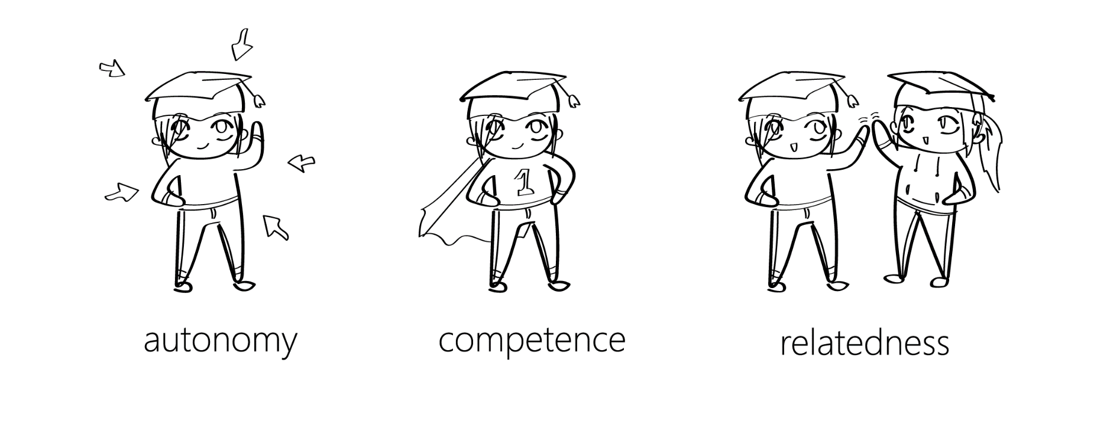
Theoretical Framework
Students particularly affected by COVID-19 pandemic (e.g., Hagemeier & Dowling-McClay, 2020; Pierce et al., 2020)
Pandemic-related stressors (Holmes et al., 2020; Taylor, 2019)
Self-Determination Theory & basic psychological needs (Deci & Ryan, 1985)

Slide 3
Research Questions
RQ.1 How has the COVID-19 pandemic, and in specific the BPN as factors within the academic learning environment, impacted student well-being one year into the pandemic?
H1. BPN Satisfaction (i.e. autonomy, competence, and relatedness) relates to heightened student well-being in the context of COVID-19.
H2. BPN Frustration relates to lower student well-being in the context of COVID-19.
RQ.2 How did students experience the interaction with teachers and fellow students in the context of COVID-19?
RQ.3 What are students’ ideas for a ‘new educational normal’?

Slide 4
Method
653 university students
56.8% Bachelor, 38.9% Master, 4,1% Pre-Master
62.2% female, 36.1% male, 1.7% other or prefer not to say
17-44 years old (M = 22.1, SD = 2.8)
23.9% international, 35.1% first-generation
Measures
Well-being: WHO-5 (World Health Organization, 1998), PANAS (Watson et al., 1988)
BPN: BPNSNF (Chen et al., 2015)
Open questions
Analysis
Multiple Regression
Content analysis
Notes:
How would you describe the interaction between you and your teachers/fellow students? / If you could help us shape the ‘new normal’ in the educational sector, what would you want it to look like?
Two multiple regression, first one control variables, second one entering the BPN

Slide 5
Results
How many students would rate their well-being low one year into the pandemic?
69.7% of students report low well-being (WHO-5 cut-off at 12.5 according to Topp et al., 2015)

Slide 6
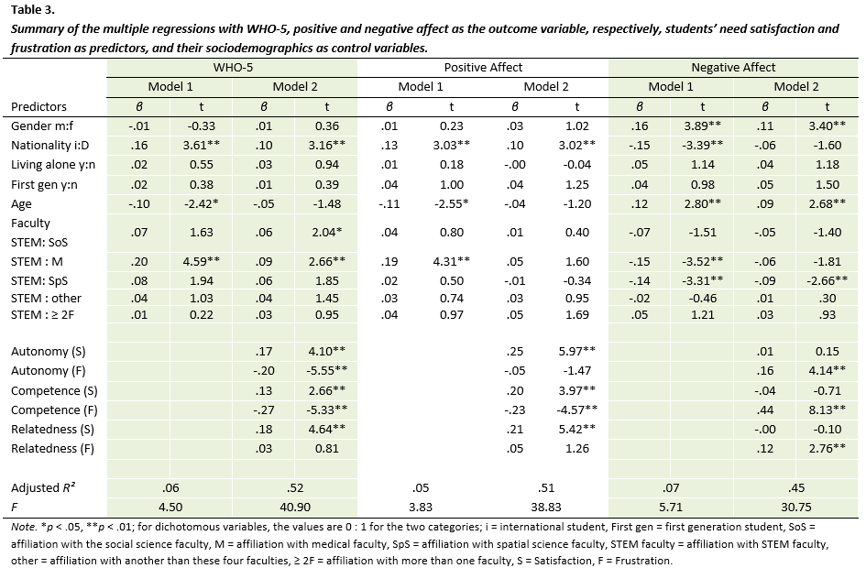
Results
Basic psychological needs as predictors
Notes:
positive affect -> BPN satisfaction, negative affect -> BPN frustration

Slide 7
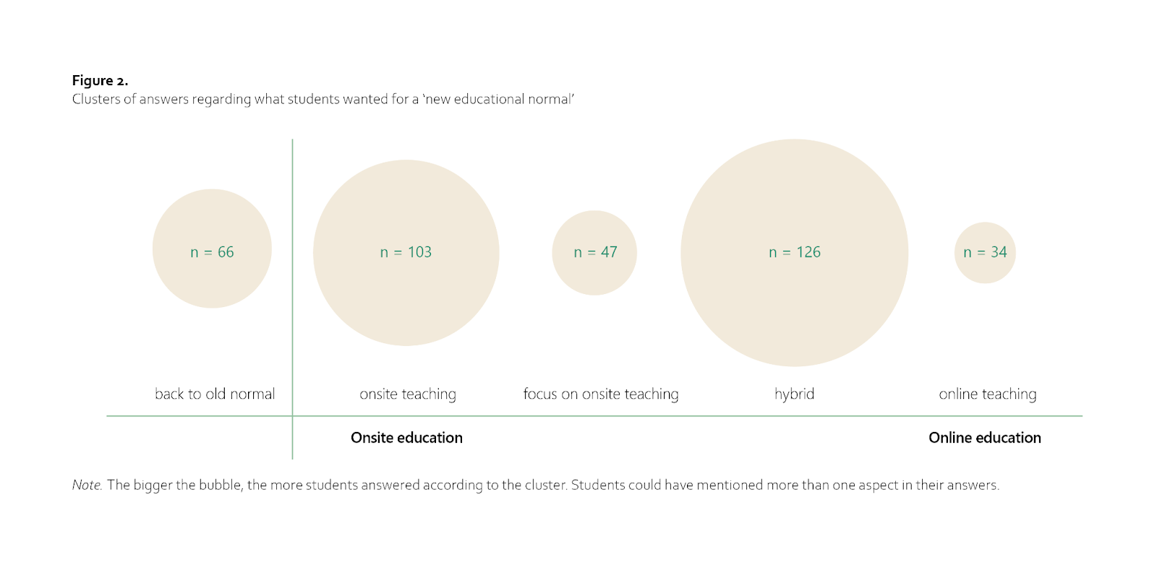
Results
Interaction with teachers
Negative and positive aspects
Teachers impact
Sense of belonging
Interaction with students
Negative and positive aspects
Group assignments
Getting to know people
Higher quality, lower quantity
Notes:
Teachers: restricted, distant & superficial, solely content-related; supportive & effort; feeling unseen & disconnected
Students: restricted, distant & superficial, pity!; supportive -> common humanity & relatedness; at-risk groups, impact learning environment; friends vs. fellow students
New normal: asynchronous teaching, definition hybrid differed; social aspect of teaching; academic culture

Slide 8
Discussion
Students’ relatedness
Quantitative and qualitative results contradictory
Explanations: understanding of relatedness may have shifted; university focuses on autonomy & competence; we may have overestimated the qualitative part
Practical implications & future research
Hybrid teaching
Focus on social cohesion at university
Limitations
Context- and time-specific
Cross-sectional
Well-being as a broader concept
Notes:
Hybrid: bigger classes online, smaller offline; combining (flipped classroom etc.); asynchronous teaching advantages

Slide 9
Take-home message
Students have been particularly affected by COVID-19
Relevance of need satisfaction & systemic impact
First directions for the post-pandemic ‘new educational normal’

Slide 10
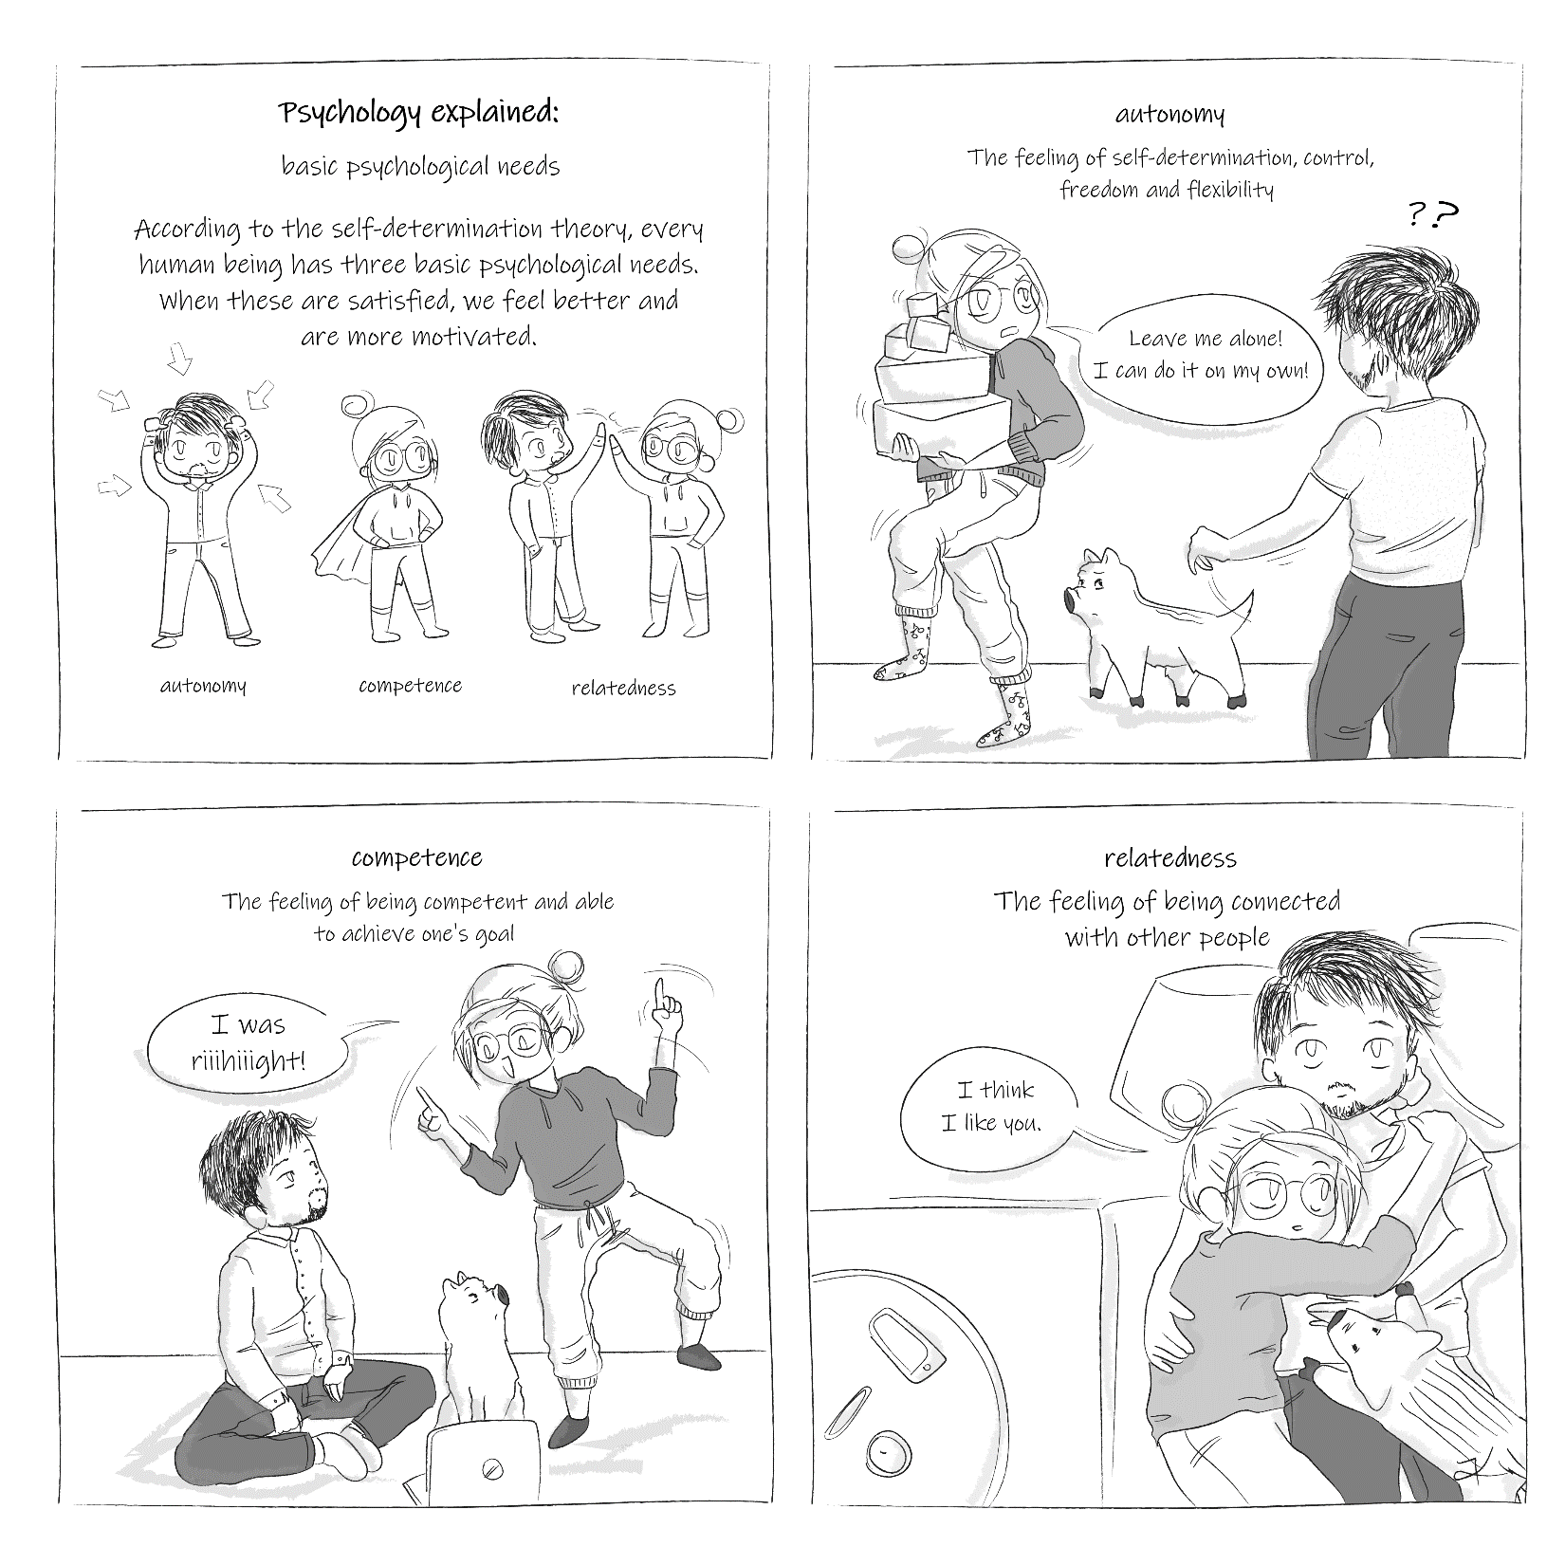
Thanks to…
University of Groningen / UMCG
Marjon Fokkens-Bruinsma
Ellen P. W. A. Jansen
Miranda Trippenzee
Joke Fleer
faculty of behavioural
and social sciences
higher education

Slide 11
Questions…?
More information at
Twitter @KiltzLisa or @floreraar
Instagram @lis.lito
https://thrive.gmw.rug.nl/

Slide 12
References
Chen, B., Vansteenkiste, M., Beyers, W., Boone, L., Deci, E. L., der Kaap-Deeder, V., Duriez, B., Lens, W., Matos, L., Mouratidis, A., Ryan, R. M., Sheldon, K. M., Soenens, B., Van Petegem, S., & Verstuyf, J. (2015). Basic psychological need satisfaction, need frustration, and need strength across four cultures. Motivation and emotion, 39(2), 216-236. https://doi.org/10.1007/s11031-014-9450-1
Deci, E. L., & Ryan, R. M. (1985). Intrinsic motivation and self-determination in human behavior. New York: Springer Science+Business Media.
Hagemeier, N. E., & Dowling-McClay, K. (2020). The Impact of COVID-19 Related Transitions on Student Well-being. American Journal of Pharmaceutical Education, 85(4), 82–91. https://doi.org/https://doi.org/10.5688/ajpe8291
Holmes, E. A., O’Connor, R. C., Perry, V. H., Tracey, I., Wessely, S., Arseneault, L., … Bullmore, E. (2020). Multidisciplinary research priorities for the COVID-19 pandemic: A call for action for mental health science. The Lancet Psychiatry, 7(6), 547–560. https://doi.org/10.1016/S2215-0366(20)30168-1
Pierce, M., Hope, H., Ford, T., Hatch, S., Hotopf, M., John, A., … Abel, K. M. (2020). Mental health before and during the COVID-19 pandemic: A longitudinal probability sample survey of the UK population. The Lancet Psychiatry, 7(10), 883–892. https://doi.org/10.1016/S2215-0366(20)30308-4
Taylor, S. (2019). The Psychology in Pandemics: Preparing for the Next Global Outbreak of Infectious Disease. Newcastle upon Tyne, UK: Cambridge Scholars Publishing.
Watson, D., Clark, L. A., & Tellegen, A. (1988). Development and validation of brief measures of positive and negative affect: the PANAS scales. Journal of Personality and Social Psychology, 54(6), 1063–1070. https://doi.org/10.1051/epjconf/201714006017
World Health Organization. (1998). WHO-Five Well-Being Index. Retrieved August 5, 2019, from https://www.psykiatri-regionh.dk/who-5/Documents/WHO5_English.pdf

